Slide 1
Hash ADT
atjahyanto@gmail.com

Slide 2
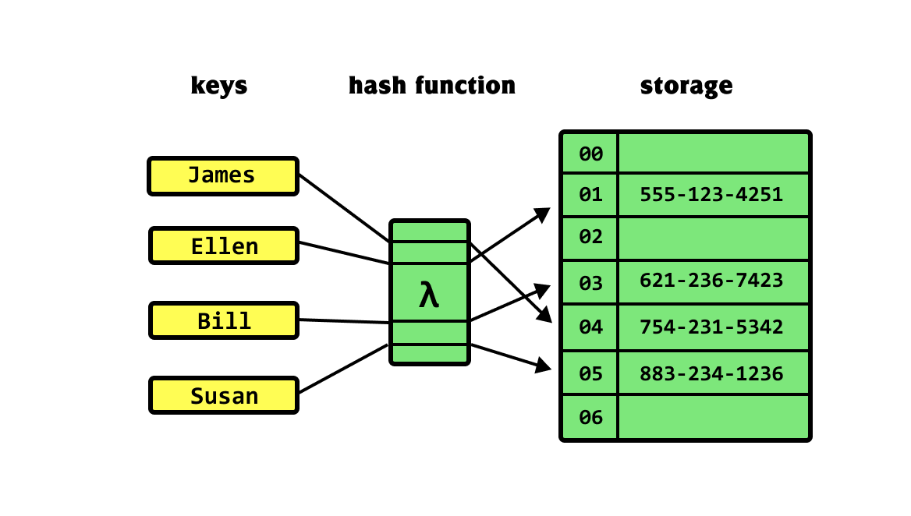
Hash ADT
Menyimpan data dalam bentuk array-like di mana setiap elemen dikaitkan dengan sebuah key.
Tujuan utama tabel hash adalah menyediakan akses cepat ke data berdasarkan key yang digunakan.

Slide 3
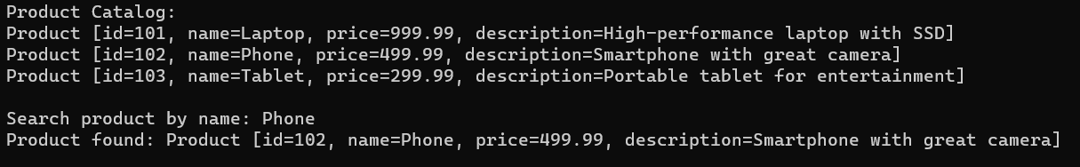
Product Catalog
import java.util.HashMap;
import java.util.Map;
class Product {
private int id;
private String name;
private double price;
private String description;
public Product(int id, String name, double price, String description) {
this.id = id;
this.name = name;
this.price = price;
this.description = description;
}
public int getId() {
return id;
}
public String getName() {
return name;
}
public double getPrice() {
return price;
}
public String getDescription() {
return description;
}
@Override
public String toString() {
return "Product [id=" + id + ", name=" + name + ", price=" + price + ", description=" + description + "]";
}
}
class ProductCatalog {
private Map<String, Product> catalogByName; // Use product name as key
public ProductCatalog() {
catalogByName = new HashMap<>();
}
public void addProduct(Product product) {
if (catalogByName.containsKey(product.getName())) {
System.out.println("Warning: Product with name '" + product.getName() + "' already exists.");
return;
}
catalogByName.put(product.getName(), product);
}
public Product getProductByName(String name) {
System.out.println("Search product by name: "+name);
return catalogByName.get(name);
}
public void displayCatalog() {
System.out.println("Product Catalog:");
for (Product product : catalogByName.values()) {
System.out.println(product);
}
System.out.println();
}
}
public class HashADTExample {
public static void main(String[] args) {
ProductCatalog catalog = new ProductCatalog();
Product product1 = new Product(101, "Laptop", 999.99, "High-performance laptop with SSD");
Product product2 = new Product(102, "Phone", 499.99, "Smartphone with great camera");
Product product3 = new Product(103, "Tablet", 299.99, "Portable tablet for entertainment");
catalog.addProduct(product1);
catalog.addProduct(product2);
catalog.addProduct(product3);
catalog.displayCatalog();
String productNameToFind = "Phone";
Product foundProduct = catalog.getProductByName(productNameToFind);
if (foundProduct != null) {
System.out.println("Product found: " + foundProduct);
} else {
System.out.println("Product not found with name: " + productNameToFind);
}
Product product4 = new Product(104, "Tablet", 400.99, "Tablet bodrex");
catalog.addProduct(product4);
catalog.displayCatalog();
}
}
String productNameToFind = "Phone";
Product foundProduct = catalog.getProductByName(productNameToFind);
if (foundProduct != null) {
System.out.println("Product found: " + foundProduct);
} else {
System.out.println("Product not found with name: " +
productNameToFind);
}

Slide 4
Product Catalog
class ProductCatalog {
private Map<String, Product> catalogByName; // Use product name as key
public ProductCatalog() {
catalogByName = new HashMap<>();
}
public void addProduct(Product product) {
catalogByName.put(product.getName(), product);
}
public Product getProductByName(String name) {
System.out.println("Search product by name: "+name);
return catalogByName.get(name);
}
// …
}

Slide 5
Product Catalog
Apa yang terjadi apabila ditambah sbb:
Product product4 = new Product(104, "Tablet", 400.99, "Tablet bodrex");
catalog.addProduct(product4);
catalog.displayCatalog();

